Slide 1
EO Self-Conformance Test (EO-CT)
ICS2 Release 2 CT Campaign (July 2022 – February 2023)
May 2022

Slide 2

Agenda
Manage Trader Preferences
Register Conformance Test Campaign
Consult Conformance Test Campaign

Slide 3
1. Manage Trader Preferences
The Manage Preferences page is the area where the user can manage communication preferences as well as configure their own AS4 Access Point(s) in STI-STP.
More specifically, with the EO-CONF (EO-Configurator) or EO-DECL (EO-Declarant) or EO-REP (EO-Representative) roles a user can configure which optional notifications s/he wants to receive or not. Those optional notifications are informative notifications and are delivered to the Actor depending on communication preferences in STI-STP.
Furthermore, with the EO-CONF (EO-Configurator) role a user can configure one or more parties (with a partyId and endpoint (URL)) and for each party, the ICS2 STI service version they support and the message exchange pattern (push or pull). The Actor can use the configured parties to set the default communication path per business domain.
STI-STP: https://conformance.customs.ec.europa.eu/gtp

Slide 4
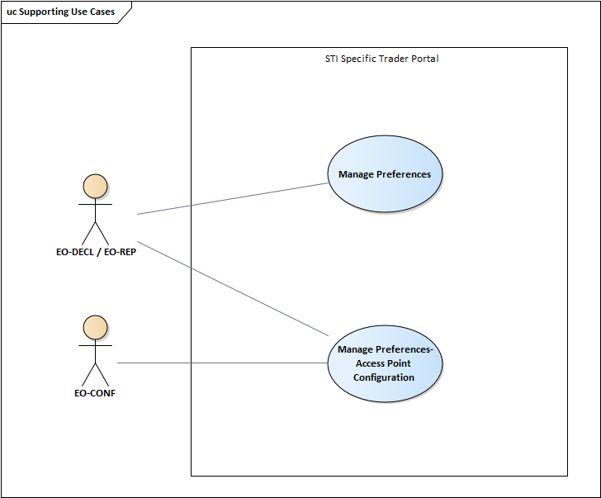
1. Manage Trader Preferences

Slide 5
1. Manage Trader Preferences
Manage Preferences page is accessible from the Navigation Menu. The system presents a list of options for the Actor to define the type of ICS2 user s/he is:
EO declarant/representative acting also as a sender
EO declarant/representative not acting as a sender or
Just acting as a sender
Options are exclusive and mandatory to choose one

Slide 6
1. Manage Trader Preferences
Relation between the option chosen in welcome page and what is displayed in Manage Preferences is depicted below:
EO declarant/representative acting also as sender:
  Optional notifications
  AP configuration
  Default communication paths
EO declarant/representative not acting as sender:
  Optional Notifications
  AP configuration
  Default Communication paths
User acting as a sender:
  AP configuration

Slide 7
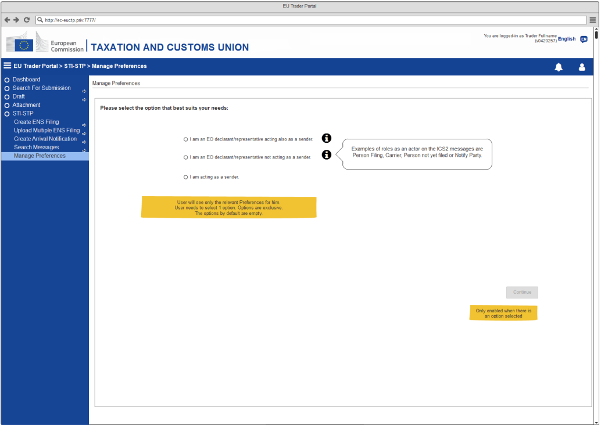
1. Manage Trader Preferences

Slide 8
1. Manage Trader Preferences
The system depending on the selection in the previous step, may present:
Switch On/Off optional ICS2 notifications either as a Person Filing or as a Carrier
Switch On/Off ICS2 notifications via STI-STP, including for ENS Filings that were not submitted through STI-STP or notifications to EOs other than the person filing with a default path different from STI-STP, duplicate notifications will be shown on the EUCTP Dashboard. (Note: The original submission channel will also receive a notification)
Configure Access Points with the Party ID and information related to communication
Configure the Communication Paths, including a default communication path for each Business Domain

Slide 9

1. Manage Trader Preferences
The system allows the user to switch ON/OFF each of the notifications
Notification switch
Switch on/off to enable or disable the notification.
IE3R01 ENS Registration Response is mandatory for the person filing the ENS and it is not editable.
The EO-DECL and EO-REP have read-only rights. No “Delete” actions and no “Add party” or “Add communication path” buttons enabled, the user is able to perform the main use case flow only.

Slide 10

1. Manage Trader Preferences
Add/Delete Communication Path
Clicking on button will display the pop-up window Add Communication Path.
The “Add Communication Path” will be described in next section
Clicking on next to the Communication Path will delete the row.
Add/Delete Party Id
    Clicking on the button will display the pop-up window Add Party Id.
    The “Add Party Id” use case will be described in next section
Clicking on next to the Party Id will delete the row.

Slide 11
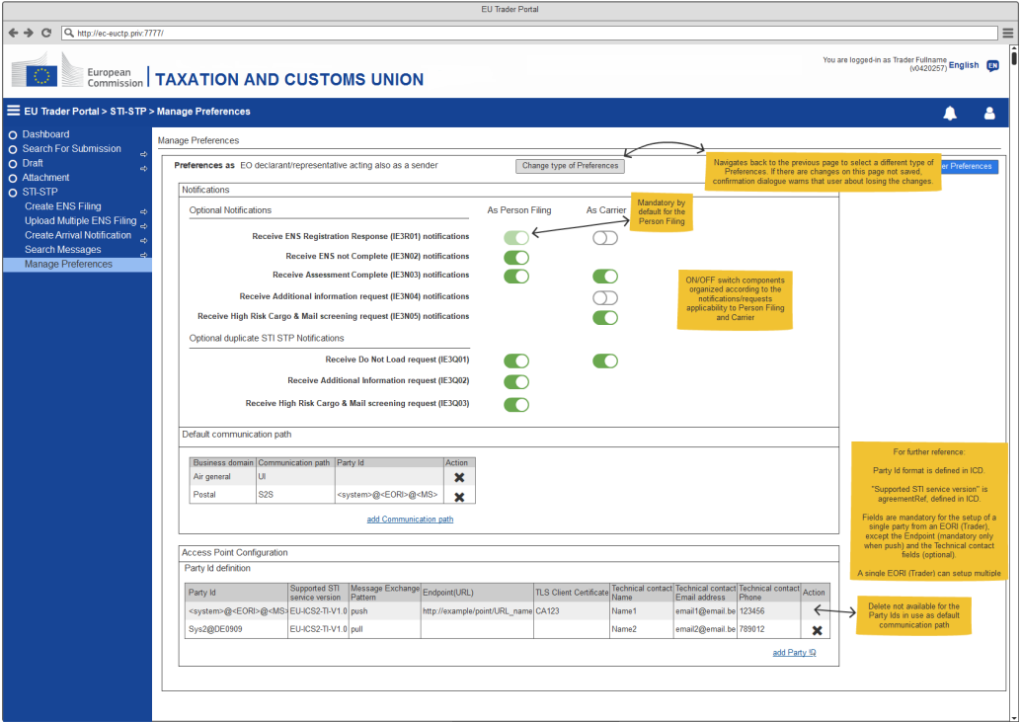
1. Manage Trader Preferences

Slide 12
1. Manage Trader Preferences
Access Point Configuration - Add Party ID
The Access Point Configuration pop-up is accessible from the Manage Preferences page, only for users with configuration rights.
This pop-up allows the user to configure an Access Point Configuration with the Party Id and information related to communication.
System presents the AP configuration form with these fields:
  PartyId such as <system>@<EORI>@<MS> (where system and MS are optional)
  Supported STI Service Version
  Message Exchange Pattern (MEP): either push or pull
  Endpoint (URL)
  TLS Client Certificate
  Contact Details (Name, E-mail address/Phone number)

Slide 13
1. Manage Trader Preferences
Access Point Configuration - Add Party ID
The Actor fills the appropriate Access Point Configuration form and use button “Save and Notify”
The Actor saves Trader Preferences
System triggers the email notifications of the Access Point Configurations selected to be notified. A confirmation notification “Your changes have been communicated to ITSM” will be provided, notifying the email has been sent (or an appropriate error otherwise).
The Actor fills the appropriate Access Point Configuration and use button Save
System will provide a verification message, informing the user of two options:
  Confirm the option, system will save the Access Point Configuration, without sending a notification to ITSM.
  Decline the option, user returns to filled Access Point Configuration form in order to Save and Notify.

Slide 14
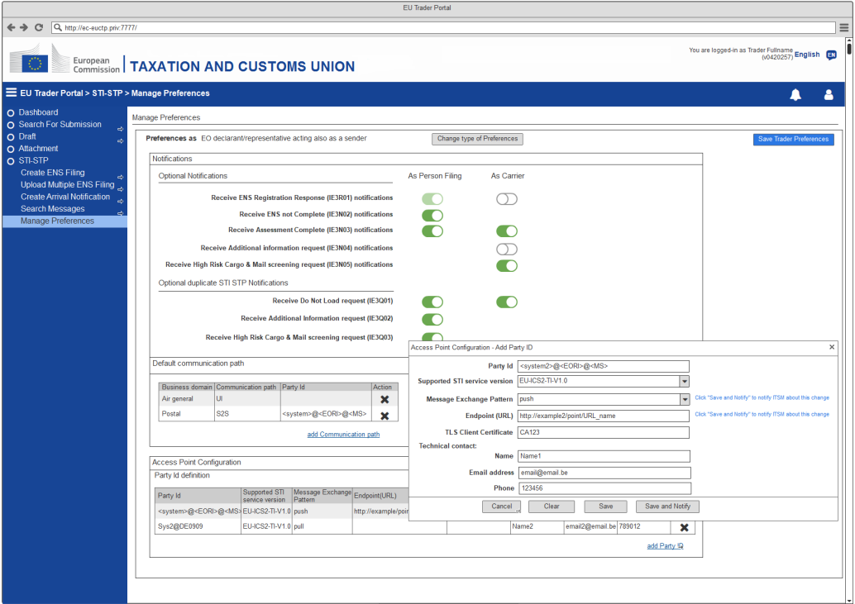
1. Manage Trader Preferences
Add Party ID: EO declarant/representative acting also as a sender

Slide 15
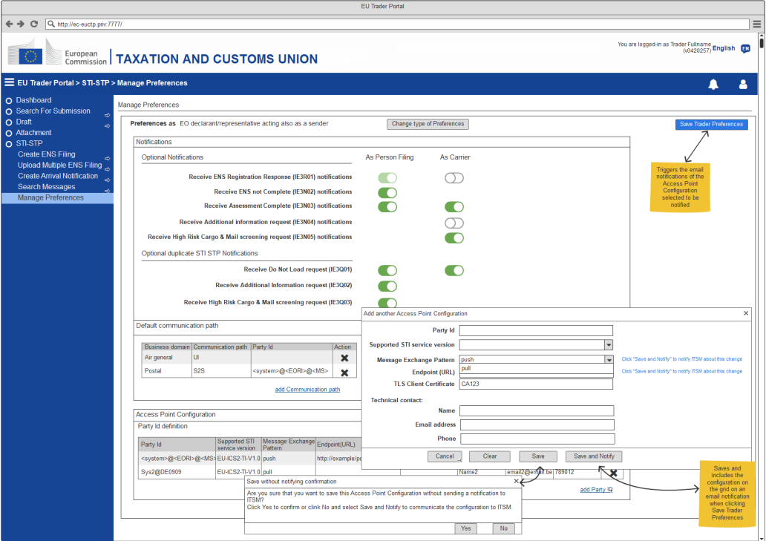
1. Manage Trader Preferences
Add AP Configuration: EO declarant/representative acting also as a sender

Slide 16
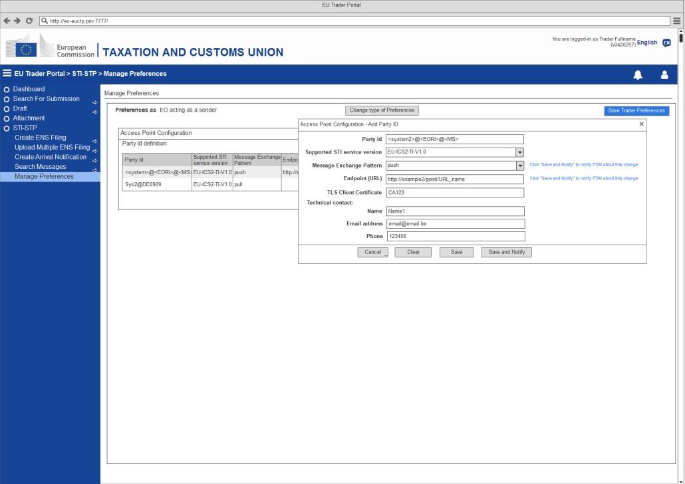
1. Manage Trader Preferences
Add Party ID: EO acting as a sender

Slide 17
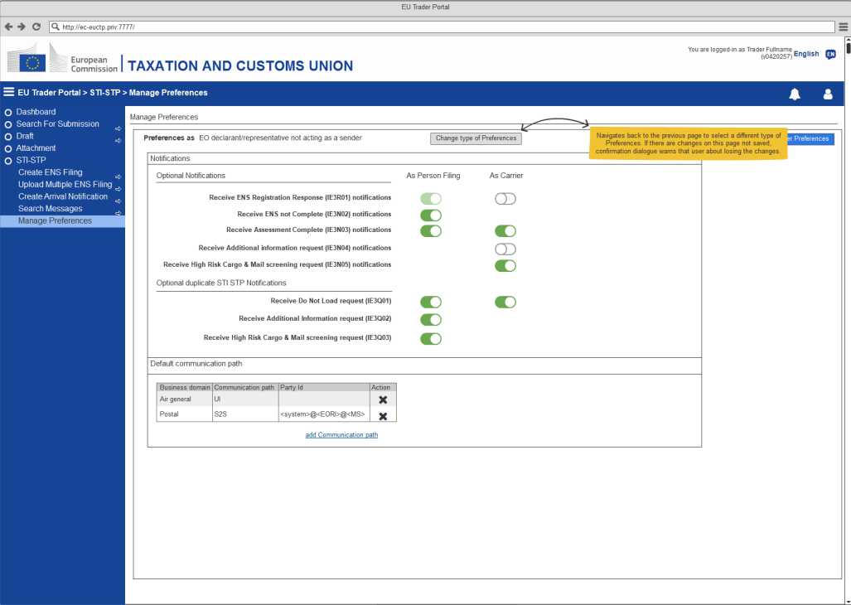
1. Manage Trader Preferences
Change type of Preferences: EO declarant/representative not acting as a sender

Slide 18
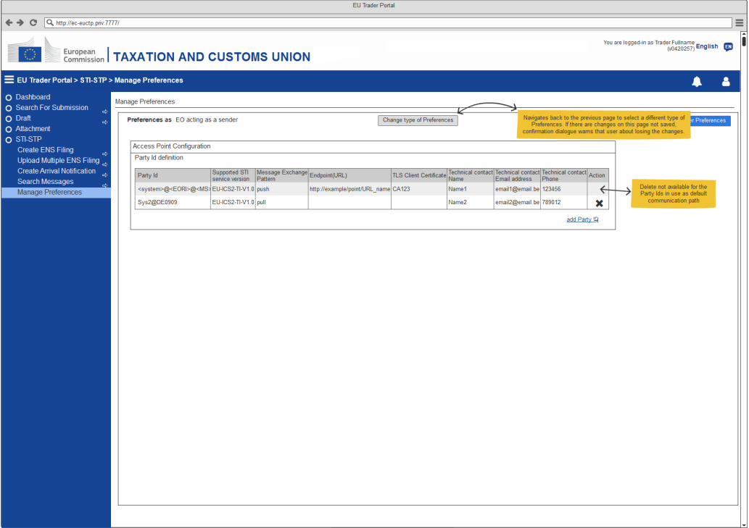
1. Manage Trader Preferences
Change type of Preferences: EO acting as a sender

Slide 19
1. Manage Trader Preferences
Access Point Configuration - Add Communication Path
The Default Communication Path pop-up is accessible from the Manage Preferences page, only for users with configuration rights.
This pop-up allows the user to define a default communication path per Business Domain.
System presents the Default communication paths, including::
  Business domain (current values: postal, air general, maritime, express, road & rail)
  Communication Path (S2S or U2S)
  PartyId (only available for S2S path)

Slide 20
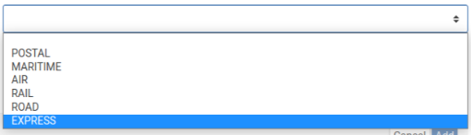

1. Manage Trader Preferences
Access Point Configuration - Add Communication Path
Business Domain
Select the Business Domain from the dropdown list:
Communication Path
Select the Communication Path from the dropdown list:

Slide 21
1. Manage Trader Preferences
Access Point Configuration - Add Communication Path
Party Id
Enter the Party Id to be used as a default communication path for the Business domain and Communication Path selected
Cancel Button
Click to close the pop-up without adding an Access Point
Add Button
Click to add the Default Communication Path into the Default Communication Path grid and close the pop-up

Slide 22
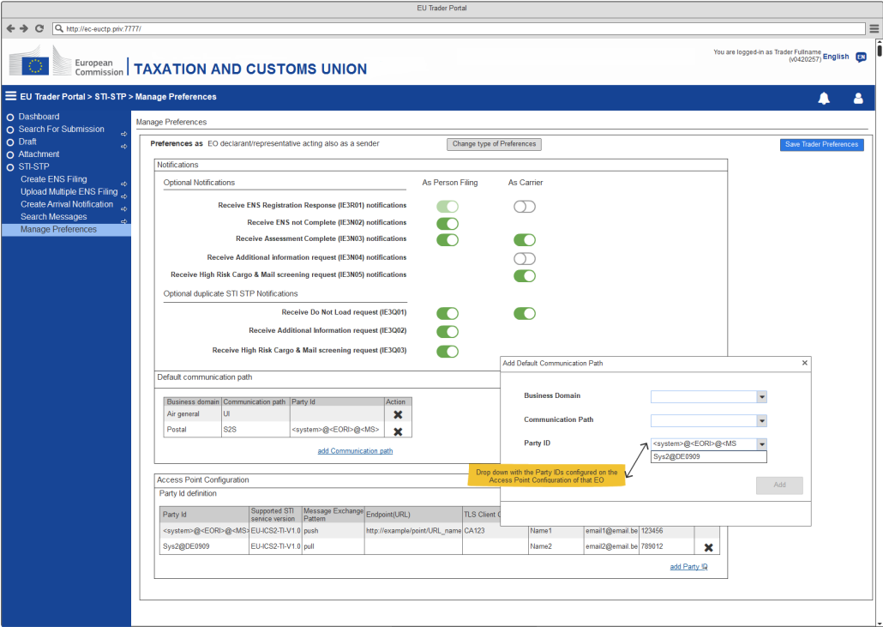
1. Manage Trader Preferences
Add Communication Path: EO declarant/representative acting also as a sender

Slide 23
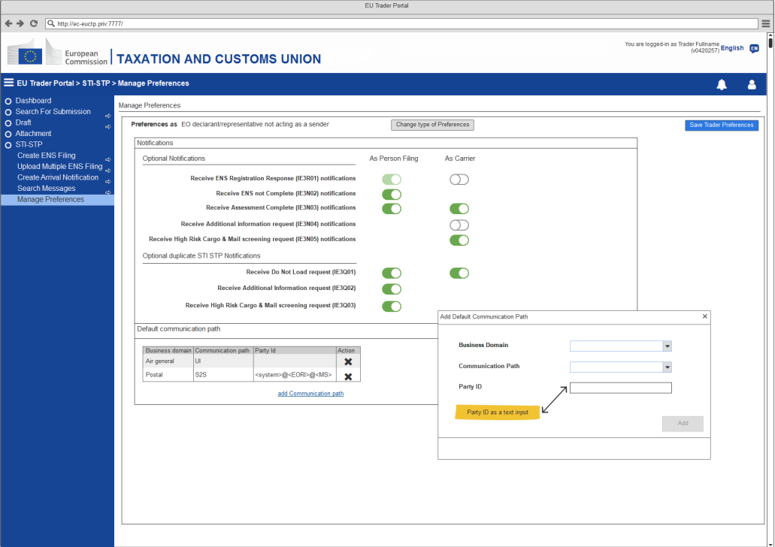
1. Manage Trader Preferences
Add Communication Path: EO declarant/representative not acting as a sender

Slide 24
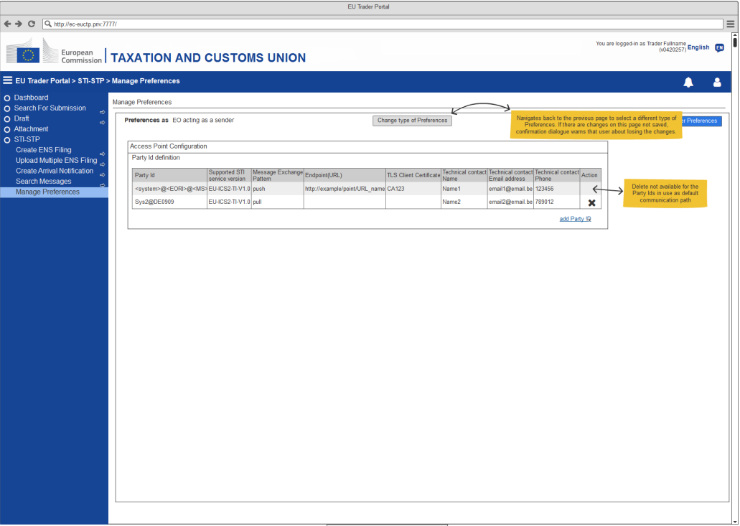
1. Manage Trader Preferences
Add Communication Path: EO acting as a sender

Slide 25
2. Register Conf Test Campaign
The Register a Self-Conformance Test Campaign is where the user can self-register a Conformance Test Campaign.
The user is able to navigate to the next or to the previous step in order to fully fill in the required information to self-register. Each time a user navigates away from one step, the system performs client-side validation of the fields of this step and notifies the user if the step includes validation errors or not. Visual marks (e.g. “red X” or “green check”) appear on the top of the steps of the ENS Filing.
With the EO-CONF (EO-Configurator) role a user can register a Conformance Test Campaign using STI-STP.
This action is applicable only in the Conformance environment.

Slide 26
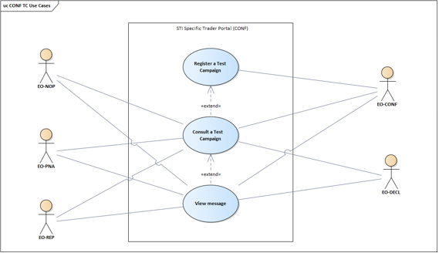
2. Register Conf Test Campaign

Slide 27
2. Register Conf Test Campaign
The Actor decides to register a Conformance Test Campaign.
The system renders the Business Roles:
  Carrier
  Express Operator
  House Filer
  Notify Party
  Person Notifying the Arrival
  Postal Operator
A set of pre-defined Business Scenarios is enabled to the Actor.
The Actor is then required to fill in the Identifiers for specific messages in the Business Scenarios pre-defined for the business role.

Slide 28
2. Register Conf Test Campaign
Pre-Conditions:
  The Actor is successfully logged into EUCTP via UUM&DS authentication and identification, in the Conformance environment.
  The Actor's STI-STP role EO-DECL, EO-REP or EO-CONF, required for this Use Case, is identified.
  STI-STP is successfully connected to STI, in the Conformance environment.
  There is an active EO CTC loaded in STI, Conformance environment. Business roles and Business Scenarios configured in STI-STP system.
  The AS4 connectivity between the EO system and ICS2 is in place (EO System certificate is properly registered in UUM&DS).

Slide 29
2. Register Conf Test Campaign
The user selects “Conformance Tests” from the STI-STP main menu
The system presents:
  Fixed message at the top “For the execution of this Conformance Test Campaign, first make sure you register a certificate and perform the technical connectivity test.”
  The information related to the active EO CTC:
    Name (e.g. CTC for Release 2)
    Start Date
    End Date

Slide 30
2. Register Conf Test Campaign
  The configuration fields to be provided for the Campaign Registration:
    Sender PartyID
    Pmode configuration (read-only field):
    Message Exchange Pattern (MEP): either push or pull;
    Endpoint (URL).
    TLS Client Certificate (read-only field)
  A “Register” button, only enabled in case the configuration fields are filled
  A CONF Test Campaign grid empty
  A link to the CIRCABC (which will lead to a public access dedicated folder named “ICS2 R2 EO Self-Conformance”)
In case no active EO CTC is loaded in STI, because CONF DB is sometimes cleaned or due to current date is out of the validity range date for the EO CTC, the data will be empty, and the Register button will be disabled.

Slide 31
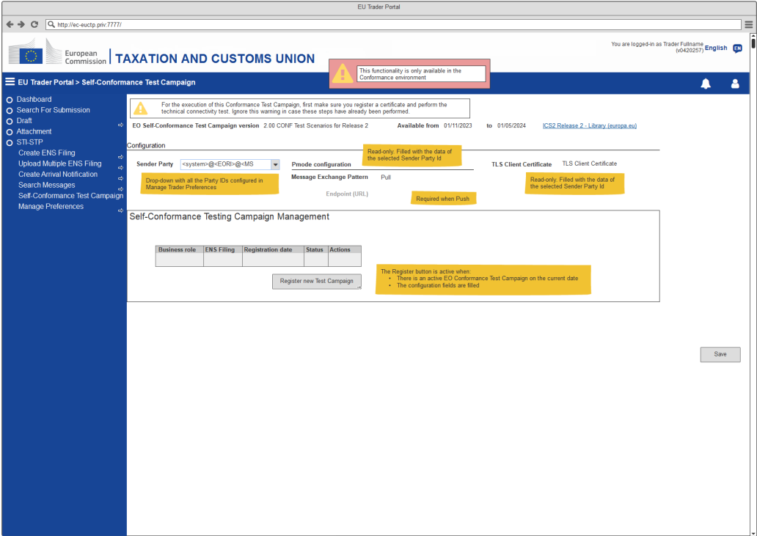
2. Register Conformance Test Campaign

Slide 32
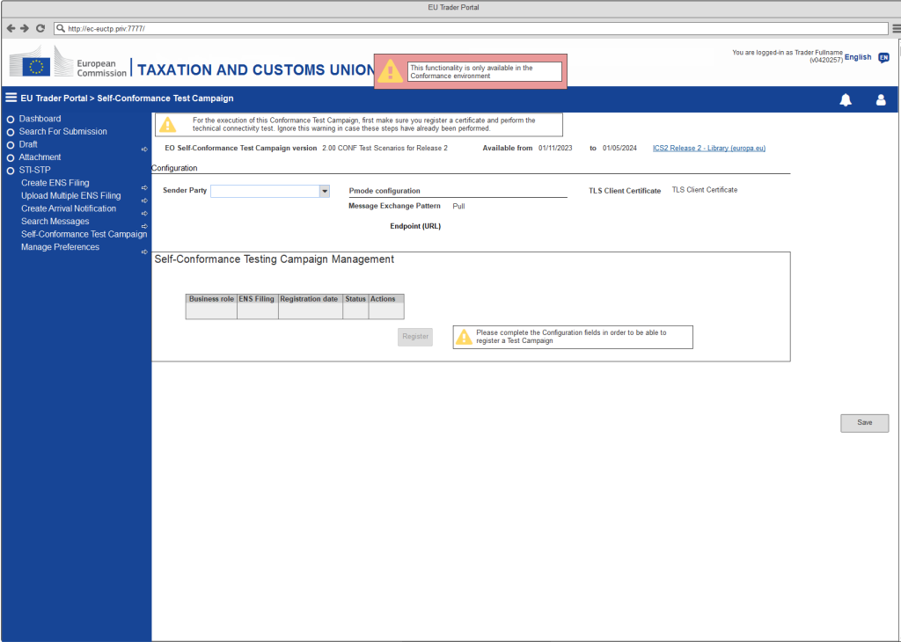
2. Register Conformance Test Campaign

Slide 33
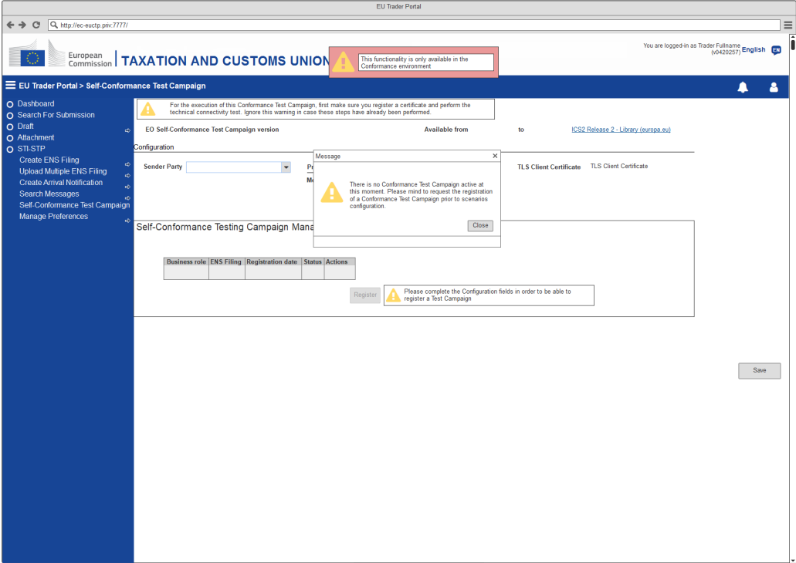
2. Register Conformance Test Campaign

Slide 34
2. Register Conformance Test Campaign
The Actor fills in the configuration fields and select to register a CONF Test Campaign
The system presents the available Business roles for the active EO CTC:
  Carrier
  Express Operator
  House Filer
  Notify Party
  Person Notifying the Arrival
  Postal Operator

Slide 35
2. Register Conformance Test Campaign
The Actor selects the Express Operator Business role
System displays a grid listing the business scenarios according to the Business Role selection
The Actor selects “Next” button option
The system presents the required Business Scenario for the selected role. The system renders a grid with the list of those messages, included in the definition of the Test Case for this Business Scenario, that required an Identifier to be filled in:
  Business Scenario
  Message sequence
  Message type
  Status (Set up pending)
  Actions (Fill Identifier)

Slide 36
2. Register Conformance Test Campaign
The Actor selects the Carrier Business role
The system presents a list with the ENS Filings available for Conformance related to Carrier
The Actor selects one ENS Filing from the list and selects “Next” button option
For each ENS Filing type selected by the Actor, the system displays a grid listing the business scenarios
The system render a list with the Business Scenarios corresponding to the ENS Filing requiring an Identifier:
  ENS Filing;
  Business Scenario
  Message sequence
  Message type
  Status (Set up pending)
  Actions (Fill Identifier)

Slide 37
2. Register Conformance Test Campaign
The Actor selects the House Filer Business role
The systems presents a list with the ENS Filings available for Conformance related to House Filer
The Actor selects one ENS Filing from the list and selects “Next” button option
For each ENS Filing type selected by the Actor, the system displays a grid listing the business scenarios
The system render a list with the Business Scenarios corresponding to the ENS Filing requiring an Identifier:
  ENS Filing;
  Business Scenario
  Message sequence
  Message type
  Status (Set up pending)
  Actions (Fill Identifier)

Slide 38
2. Register Conformance Test Campaign
The Actor selects the Postal Operator Business role
System displays a grid, listing the business scenarios according to the Business Role selection
The Actor selects “Next” button option
The system presents the required Business Scenario for the selected role. The system renders a grid with the list of those messages, included in the definition of the Test Case for this Business Scenario, that required an Identifier to be informed by the Actor:
  Business Scenario
  Message sequence
  Message type
  Status (Set up pending)
  Actions (Fill Identifier)

Slide 39
2. Register Conformance Test Campaign
For the Business Roles: Express Operator, Carrier, House Filer, Postal Operator the Actor fills all or some Identifiers and saves the grid
The system presents the information of the registered CONF Test Campaign in a grid with:
  Business role
  ENS Filing (only applicable and filled with values for Carrier and House Filer business roles)
  Registration date
  Status (Ready for execution)
  Actions (View)

Slide 40
2. Register Conformance Test Campaign
The Actor selects the Notify Party Business role
System displays a grid, listing the business scenarios according to the Business Role selection
The Actor selects a Business Scenario
The system displays a confirmation dialogue to the Actor requesting the Actor confirmation to proceed with the Business Scenario execution.
The system displays the message: “For this Business Role there are no identifiers to be configured by you. Please press Finish Configuration to confirm the Registration.”

Slide 41

2. Register Conformance Test Campaign
The Actor selects the Person Notifying the Arrival Business role
System displays a grid, listing the business scenarios according to the Business Role selection
The Actor selects a Business Scenario
The system displays a confirmation dialogue to the Actor requesting the Actor confirmation to proceed with the Business Scenario execution. The system displays the information message: “For this Business Role there are no identifiers to be configured by you. Please press Finish Configuration to confirm the Registration.”
The Actor is self-registered with one of the referred selected Business role and is ready to start the Conformance Test Campaign

Slide 42
2. Register Conformance Test Campaign
For the cases where the following pre-condition is not fulfilled:
  “There is an active EO CTC loaded in STI, Conformance environment. Business roles and Business Scenarios configured in STI-STP system.”
The System displays a message informing the Actor. The informative message contains the following content: "There is no Conformance Test Campaign active at this moment. Please mind to request the registration of a Conformance Test Campaign prior to scenarios configuration."
  Sender Party ID field, is a drop-down list containing all Party IDs (based on Manage Trader Preferences configuration). Filter is used in order to present Party IDs with the same EORI as the EORI of the user configuring the Self-CTC. The first value of the drop-down will appear as default.
  Pmode configuration fields will appear as read-only and filled with selected Sender Party ID data.
  TLS Client Certificate, is a read-only field, filled with the data of the selected Sender Party ID.

Slide 43
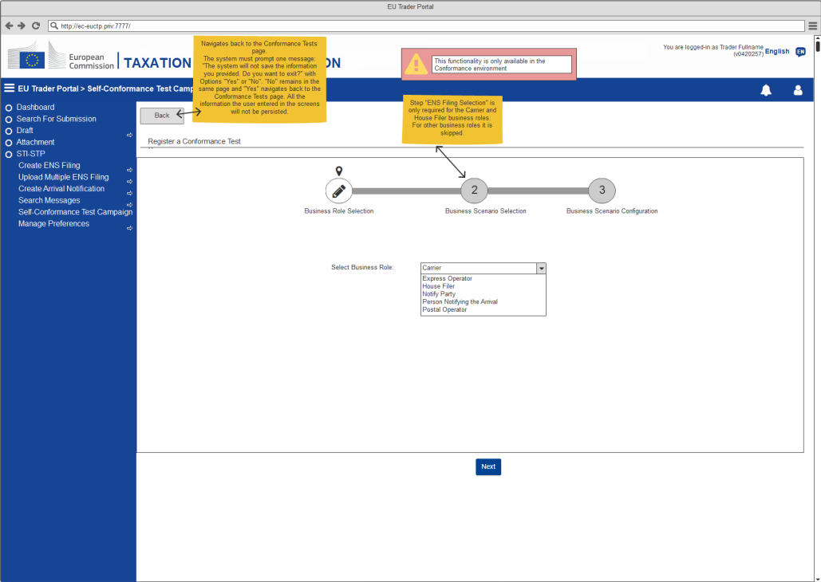
2. Register Conformance Test Campaign
Business Role selection: Carrier

Slide 44
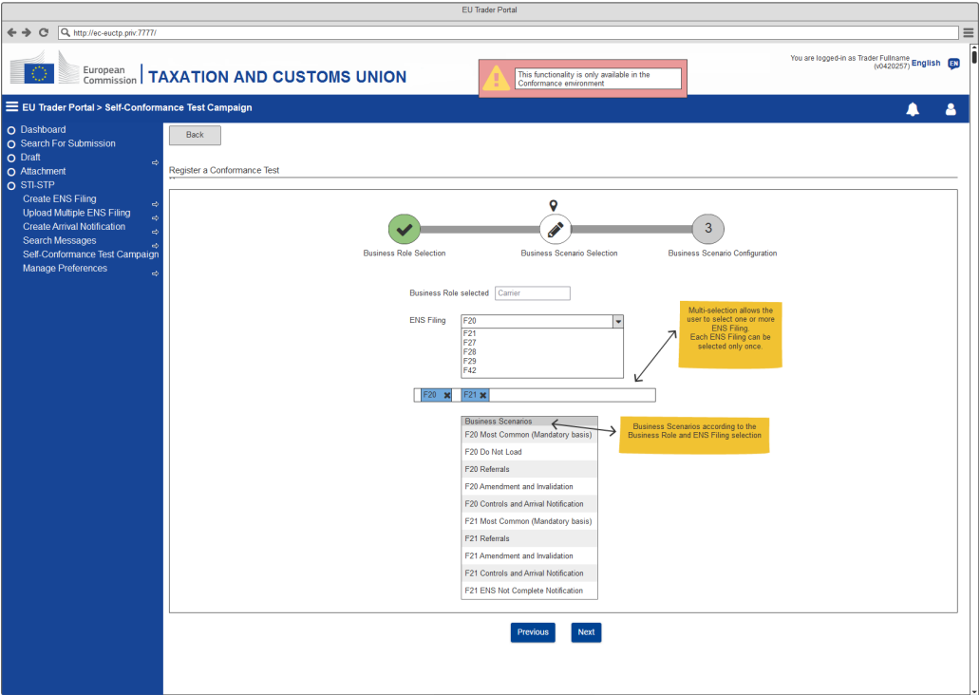
2. Register Conformance Test Campaign
ENS Filing selection: Carrier

Slide 45
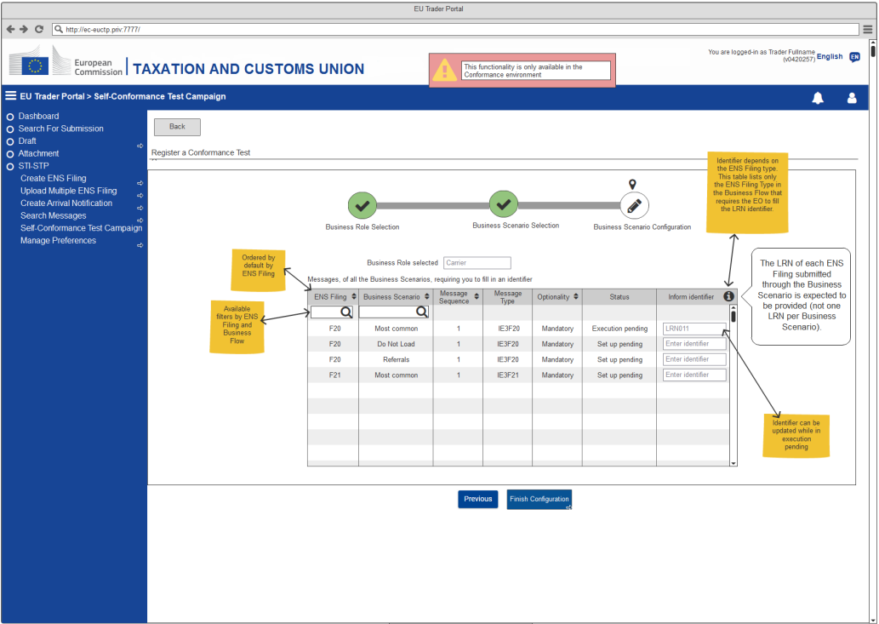
2. Register Conformance Test Campaign
Scenario Configuration: Carrier

Slide 46
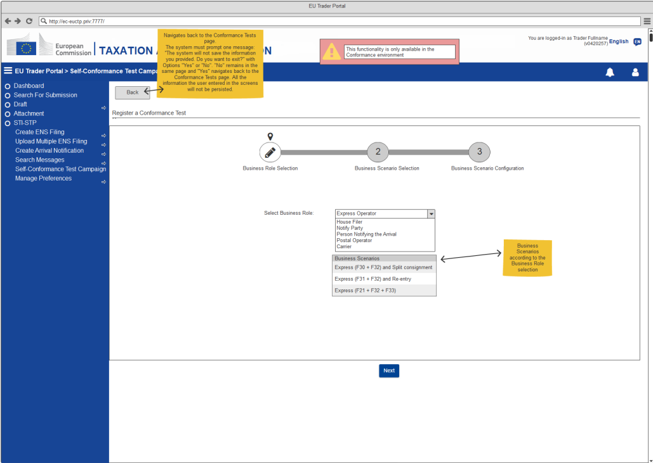
2. Register Conformance Test Campaign
Business Role selection: Express Operator

Slide 47
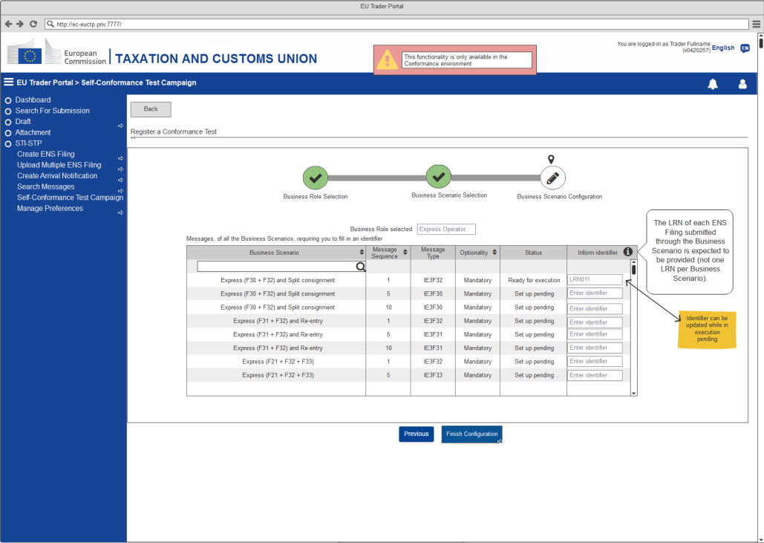
2. Register Conformance Test Campaign
Scenario Configuration: Express Operator

Slide 48
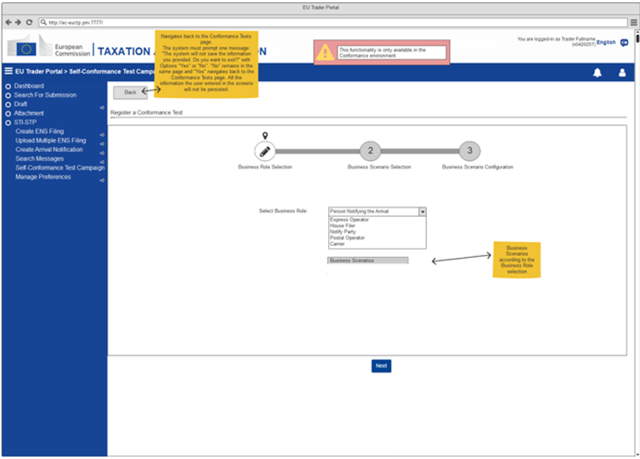
2. Register Conformance Test Campaign
Business Role selection: Person Notifying the Arrival

Slide 49
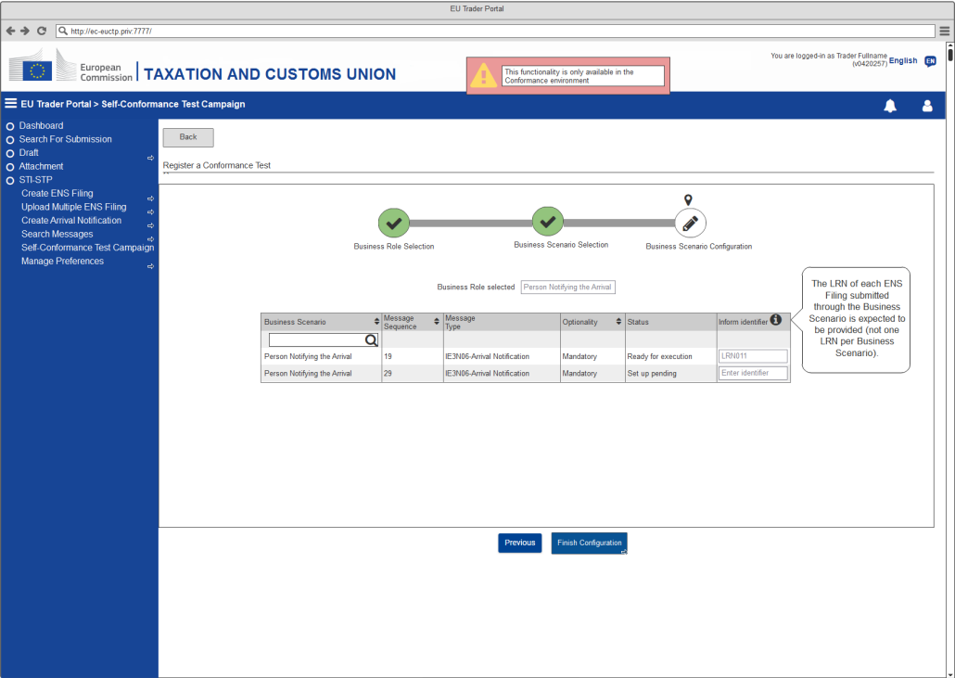
2. Register Conformance Test Campaign
Scenario Configuration: Person Notifying the Arrival

Slide 50
2. Register Conformance Test Campaign
The specification (Connectivity Test Cases, Business roles, Business Scenario and sample data) of the EO CTC is available in EO-CTS artefact (ICS2 Test Design Specifications for Economic Operator Conformance Test Scenarios R2).
The representation below intends to present a summary of the Business Scenarios required per business role: Postal Operator, Notify Party, Express Operator and Person Notifying the Arrival:
In terms of Carrier and House Filer, the required business flows are presented per ENS Filing type:

Slide 51
3. Consult Conformance Test Campaign
The Test Campaign Business Scenarios is the area where the user can consult the Business Scenarios details of a registered Self-Conformance Test Campaign. As the Self-Conformance Test Campaign page, this page also is only available in the Conformance Environment.
With the EO-DECL (EO-Declarant), EO-REP (EO-Representative), EO-CONF (EO-Configurator), EO-PNA (EO-Person Notifying Arrival) or EO-NOP (EO-Notifying Party) roles a user can consult a Conformance Test Campaign using STI-STP.

Slide 52
3. Consult Conformance Test Campaign

Slide 53
3. Consult Conformance Test Campaign
The Actor decides to consult a Conformance Test Campaign.
The system renders information about the Campaign in which the Actor is registered at the level of Business role, Scenario and Message.
Pre-Conditions:
  The Actor is successfully logged into EUCTP via UUM&DS authentication and identification, in the Conformance environment.
  The Actor's STI-STP role EO-DECL, EO-REP or EO-CONF, required for this UC, is identified.
  STI-STP is successfully connected to STI, in the Conformance environment.
  There is an active EO CTC loaded in STI, Conformance environment. Business roles and Business Scenarios configured in STI-STP system.
  The AS4 connectivity between the EO system and ICS2 is in place (EO System certificate is properly registered in UUM&DS).

Slide 54
3. Consult Conformance Test Campaign
The Actor selects “Conformance Tests” from the STI-STP main menu
The system presents:
  The information related to the active EO CTC:
    Name
    Start Date
    End Date
  The test Campaign configuration fields:
    Sender PartyID
    Pmode configuration
    TLS Client Certificate

Slide 55
3. Consult Conformance Test Campaign
  A grid with the list of Business Scenarios the Actor is registered:
    Business role;
    ENS Filing;
    Registration date;
    Status (Ready for execution / In progress / Failed / Success);
    Actions (View).
  A “Register” button.

Slide 56
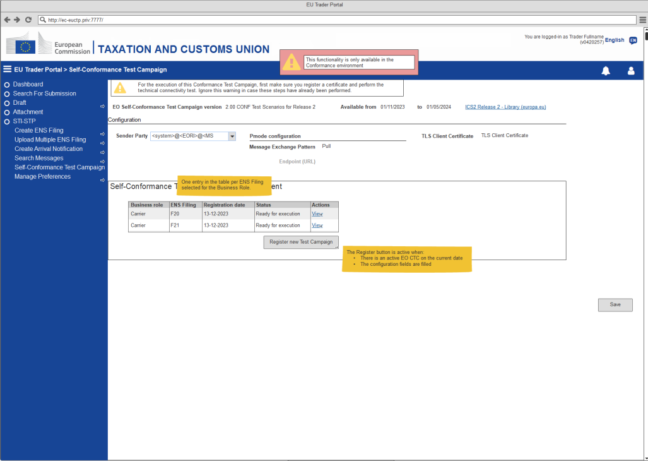
3. Consult Conformance Test Campaign
View Registered Conformance Campaign: Carrier

Slide 57
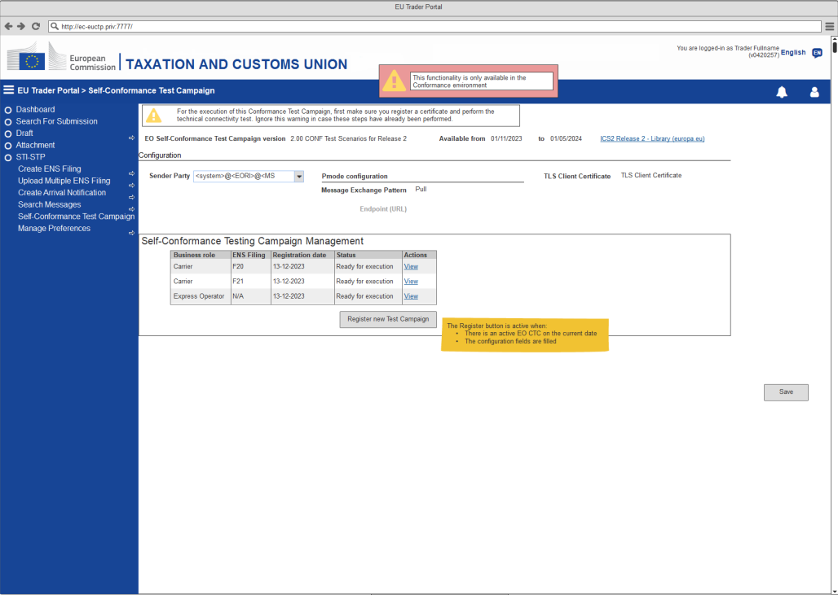
3. Consult Conformance Test Campaign
View Registered Conformance Campaign: Carrier & Express Operator
This section lists all the available active Business Roles

Slide 58
3. Consult Conformance Test Campaign
The Actor selects to view a Test Campaign
The system presents a grid with all the Business Scenario included for the Business role and scenario of the selected Campaign:
  Business Flow description;
  ENS Filing
  Business Flow status (Set up pending / Ready for execution / In progress / Failed / Success)
  Actions (View and Launch Test for specific Business Flow)

Slide 59
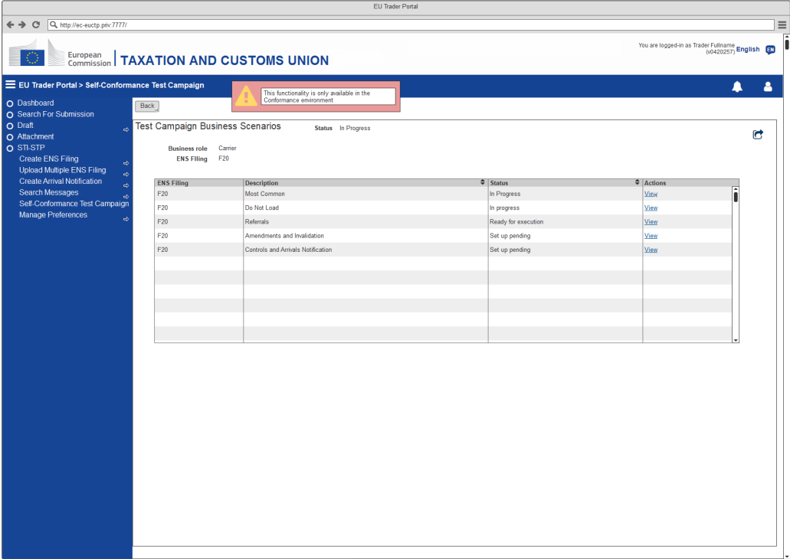
3. Consult Conformance Test Campaign
View Business Flows: F20

Slide 60
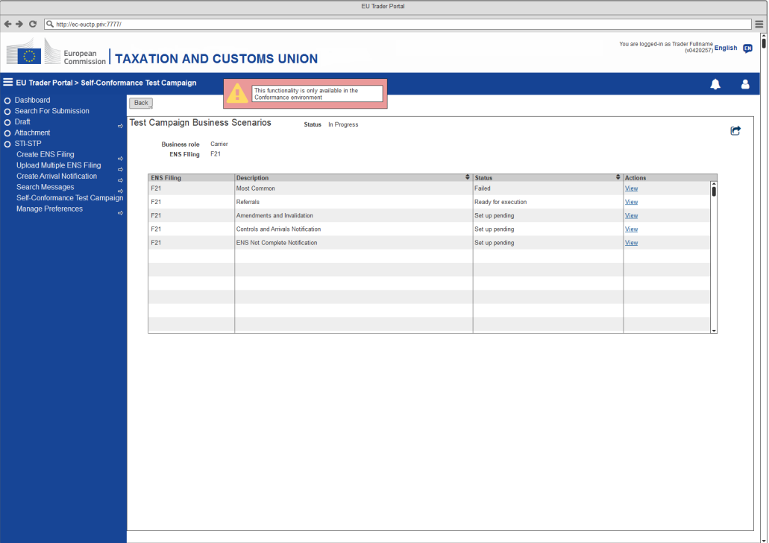
3. Consult Conformance Test Campaign
View Business Flows: F21

Slide 61
3. Consult Conformance Test Campaign
The Actor selects to view a specific Business Flow
The system renders a grid with the list of messages of the Business Scenario:
  Message sequence
  Message type
  Identifier (if filled or generated by the system)
  Additional Information
  Optionality
  Execution date (if Sent/Received)
  STI Status (Set up pending / Execution pending / Failed / Success)
  Actions (Fill Identifier / Update Identifier / View)
A button to “Reset” and a “Refresh” one are also presented.

Slide 62
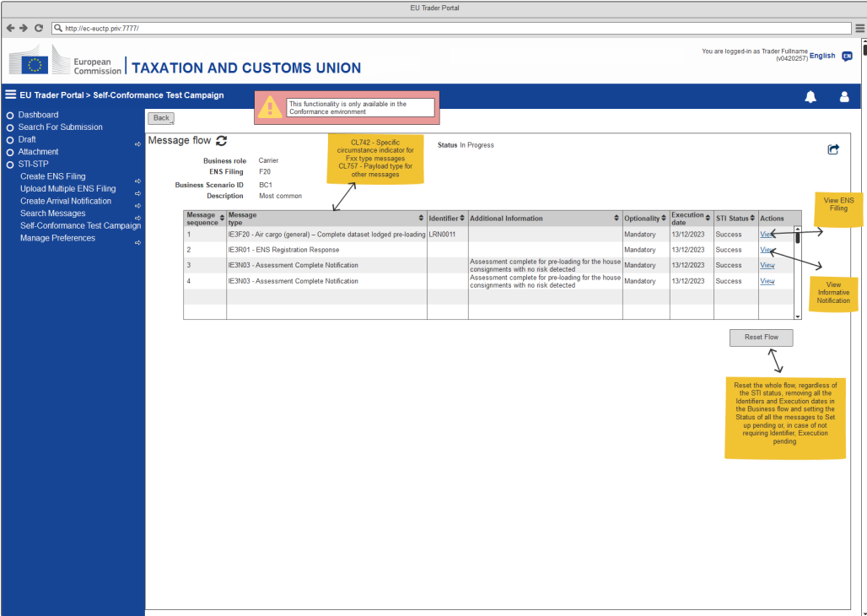
3. Consult Conformance Test Campaign
View Message Flow

Slide 63
3. Consult Conformance Test Campaign
The Actor selects to View a Failed/Success message
System provides, in read only mode, the ENS Filing form associated with current ENS Filing.
The Actor with EO-CONF role is not able to View a Failed/Success message
[for all messages]
The data of one message is presented to the Actor in read only mode.

Slide 64
3. Consult Conformance Test Campaign
The list only contains message for which:
  The EORI of the EO-DECL logged in user matches the declarant EORI
  The EORI of the EO-REP logged in user matches the representative EORI
Except for the messages below:
  IE3N03, IE3N09, IE3Q01 and IE3R01:
    The EORI of the EO-DECL logged in user must match either the declarant or the Carrier Identification Number
    The EORI of the EO-REP logged in user must match the representative
  IE3N04, IE3N05: the EORI of the EO-DECL or EO-REP logged in user must match the Carrier Identification Number
  IE3N08, IE3R04: the EORI of the EO-DECL or EO-REP logged in user must match the Person Notifying the Arrival Identification Number
  IE3N11: the EORI of the EO-DECL or EO-REP logged in user must match the Supplementary Declarant (person not yet filed) Identification Number

Slide 65
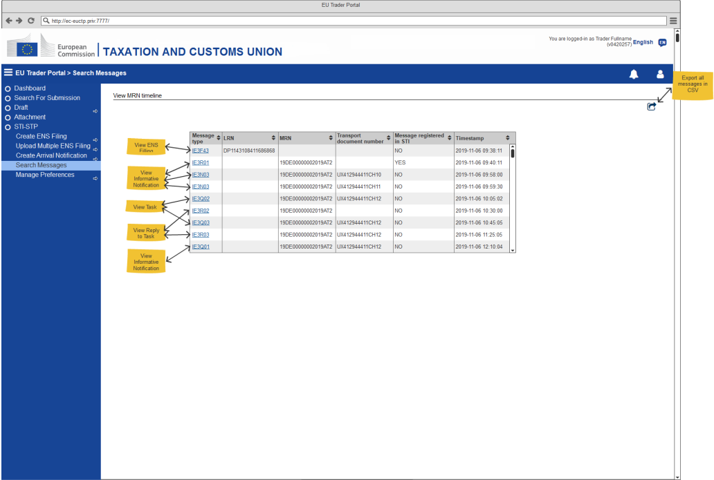
3. Consult Conformance Test Campaign
View MRN Timeline

Slide 66
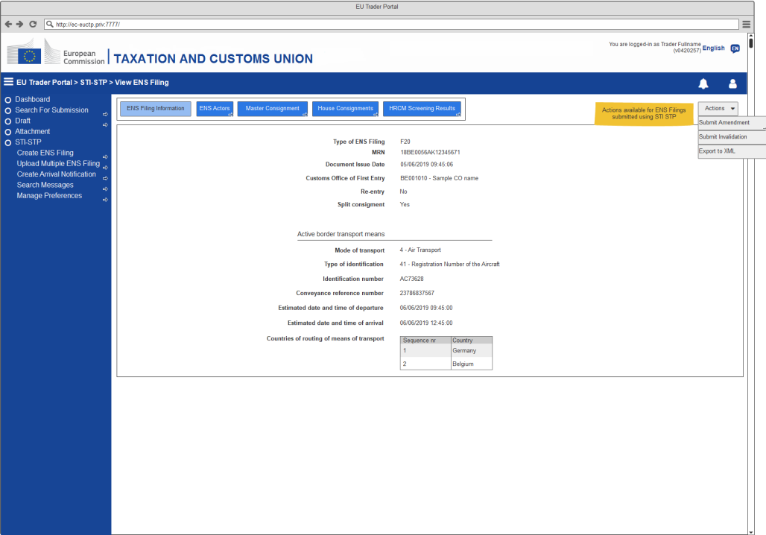
3. Consult Conformance Test Campaign
View ENS Filing: ENS Filing Information

Slide 67
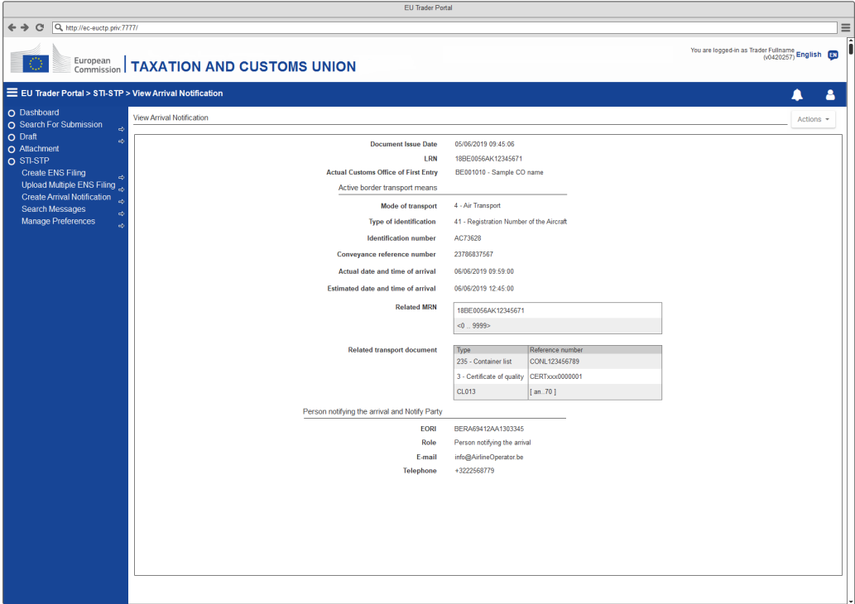
3. Consult Conformance Test Campaign
View Arrival Notification

Slide 68
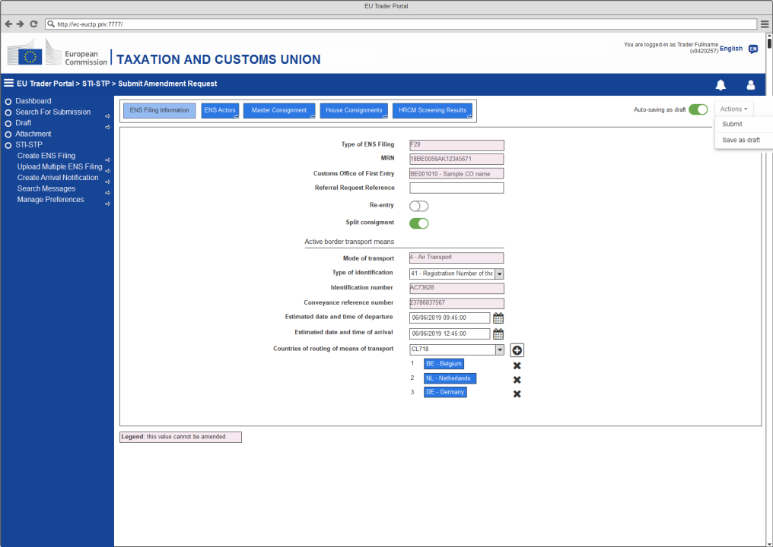
3. Consult Conformance Test Campaign
Amend ENS Filing: ENS Filing Information

Slide 69
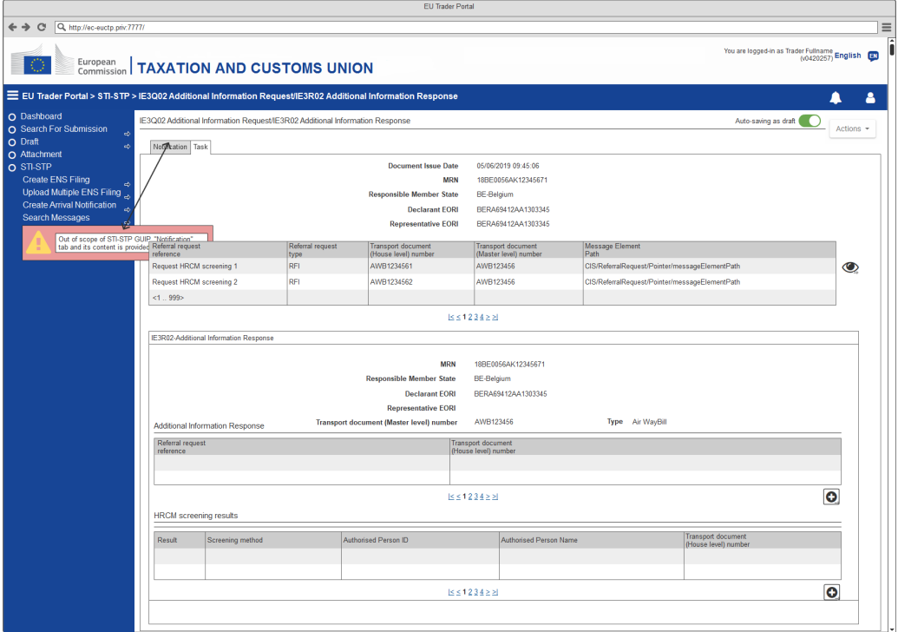
3. Consult Conformance Test Campaign
View Task

Slide 70
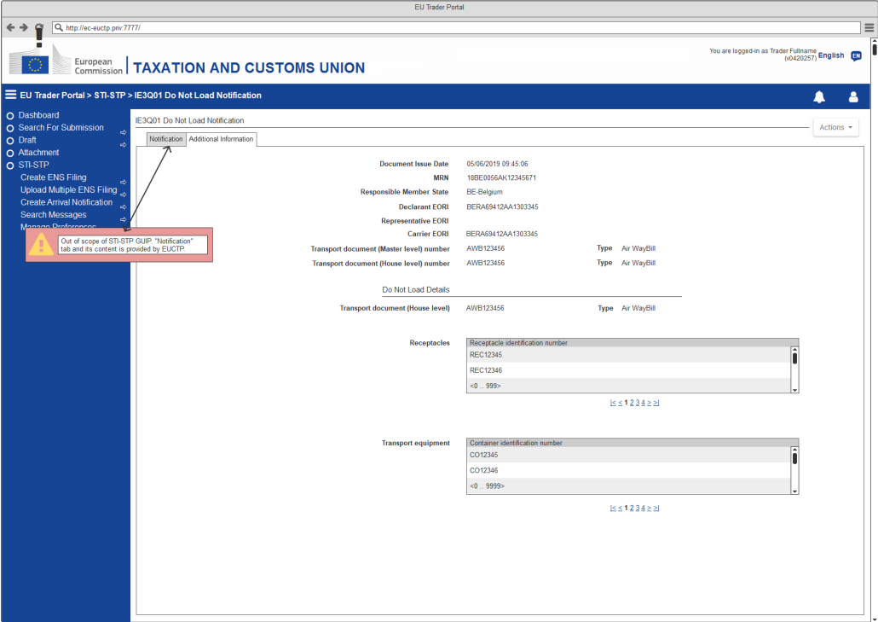
3. Consult Conformance Test Campaign
View Notification

Slide 71
3. Consult Conformance Test Campaign
The Actor is not registered in any Campaign
The Test Campaign grid is empty
The Actor selects to export the grid with the list of Business Scenarios
System uses EUCTP functionality to export list of Business Scenarios in CSV format
The Actor (Business Role “Person notifying the Arrival”, “Notify Party” or “House Filer” (when ENS Filing is “F22 ENS Pending notification” or “F26 ENS Pending notification”)) selects to Launch Test for a specific Business Flow with Status Ready for Execution
System will initiate the ENS Registration to be mocked. Then the system will change the Status into “In Progress”
The Actor selects to export the grid with the list of messages included in the “Business Scenario”
System uses EUCTP functionality to export list of Messages in CSV format

Slide 72

3. Consult Conformance Test Campaign
View Business Flows: Person Notifying the Arrival

Slide 73
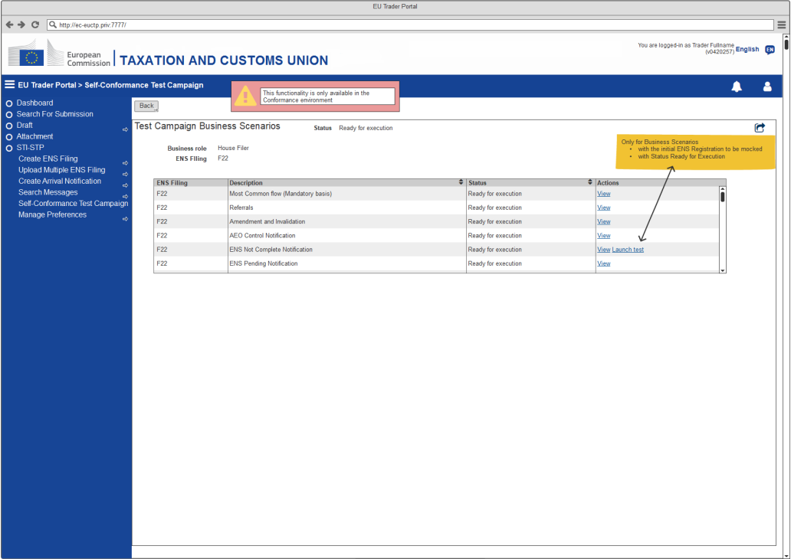
3. Consult Conformance Test Campaign
View Business Flows: F22 (With Launch Test)

Slide 74
3. Consult Conformance Test Campaign
The Actor selects to fill the Identifier of a message with Status Set up pending
The system updates the entry in the messages grid with the value of the Identifier and sets the Status to Execution pending.
The Actor selects to Update the Identifier of a message with Status Execution pending or Failed.
The system updates the entry in the messages grid with the new value of the Identifier. If the Status of the message was Failed, the system updates it to Execution pending.
The Actor clicks the Reset Business Scenario button
The system removes all the Identifiers in the Business Scenario and sets the Status of all the messages to Set up pending or Execution pending. If the flow has the initial ENS registration to be mocked, the system also launches the flow.

Slide 75
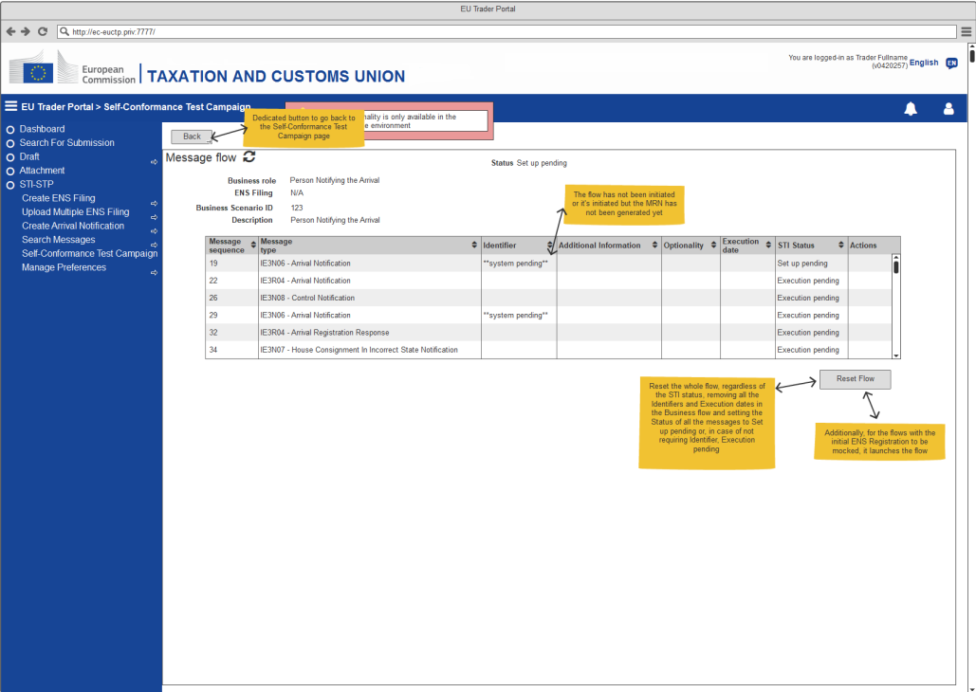
3. Consult Conformance Test Campaign
View Message Flow

Slide 76
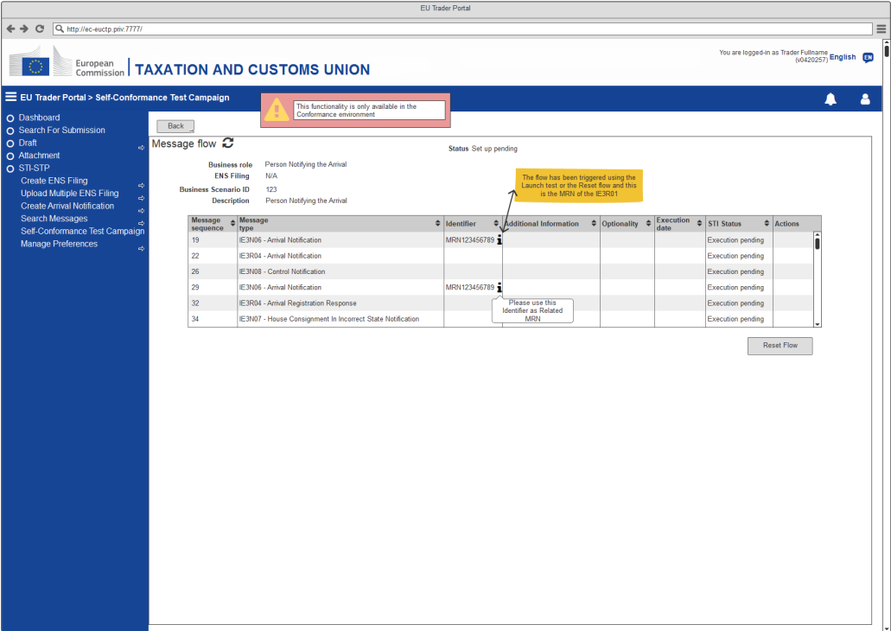
3. Consult Conformance Test Campaign
View Message Flow

Slide 77
3. Consult Conformance Test Campaign
The available Action to the Actor, for each Message, depends on its Status and Type:
The Actor follows up the progression of the execution of his Test Campaign

Slide 78
3. Consult Conformance Test Campaign
The specifications (Business roles, Business Scenarios, Scenarios and message flows) of the Economic Operator Conformance Test Campaign is available in EO-CTS artefact (ICS2 Test Design Specifications for Economic Operator Conformance Test Scenarios R2)
The transition of the Message Status to Failed/Success is managed by STI.
The Status values and possible transitions are defined below:

Slide 79
Conformance Baseline – CFSS/CTSS
Source of Documentation & Material
EOs should visit these webpages and familiarize themselves on the terminology and the ICS2 components that will use to access and consult
CIRCABC
https://circabc.europa.eu/ui/group/ea5f882b-9153-4fc1-9394-54ac8fe9149a/library/e23dba00-f6fd-4d2b-bf52-ec4450629d27
Europa Webpage
https://ec.europa.eu/taxation_customs/customs-4/customs-security/import-control-system-2-ics2-0_en
Customs & Tax EU Learning Portal
https://customs-taxation.learning.europa.eu/

Slide 80


Slide 81

Thank you
© European Union 2022
Unless otherwise noted the reuse of this presentation is authorised under the CC BY 4.0 license. For any use or reproduction of elements that are not owned by the EU, permission may need to be sought directly from the respective right holders.
Notes:
Update/add/delete parts of the copy right notice where appropriate.
More information: https://myintracomm.ec.europa.eu/corp/intellectual-property/Documents/2019_Reuse-guidelines%28CC-BY%29.pdf

